Slide 1

Mapping Resilience: Emergency Centers Planning for Low-Income Communities Facing Extreme Weather Events
01
02
03
Climate Jays Presents:
Problem
Low-income communities are severely impacted by floods and heatwaves, often lacking timely access to critical resources and emergency services.
Solution
Data-driven emergency centers providing medical care, food distribution, and volunteer coordination, designed using historical data on floods, temperatures, elevation, power outages.
Unique Approach
We combine community input with data analysis across environmental science, engineering, and public health to select optimal locations, using flood patterns, temperature records, elevation risks, and insurance coverage data.
Notes:
Solution: A targeted, data-driven mapping tool that identifies high-need sites for emergency centers serving low-income communities in King County. By layering historical data on flood patterns, temperature trends, elevation risks, and power outage incidents, we can pinpoint strategic locations for centers optimized for medical care, food distribution, and volunteer mobilization, ready to support communities during extreme weather events.

Slide 2
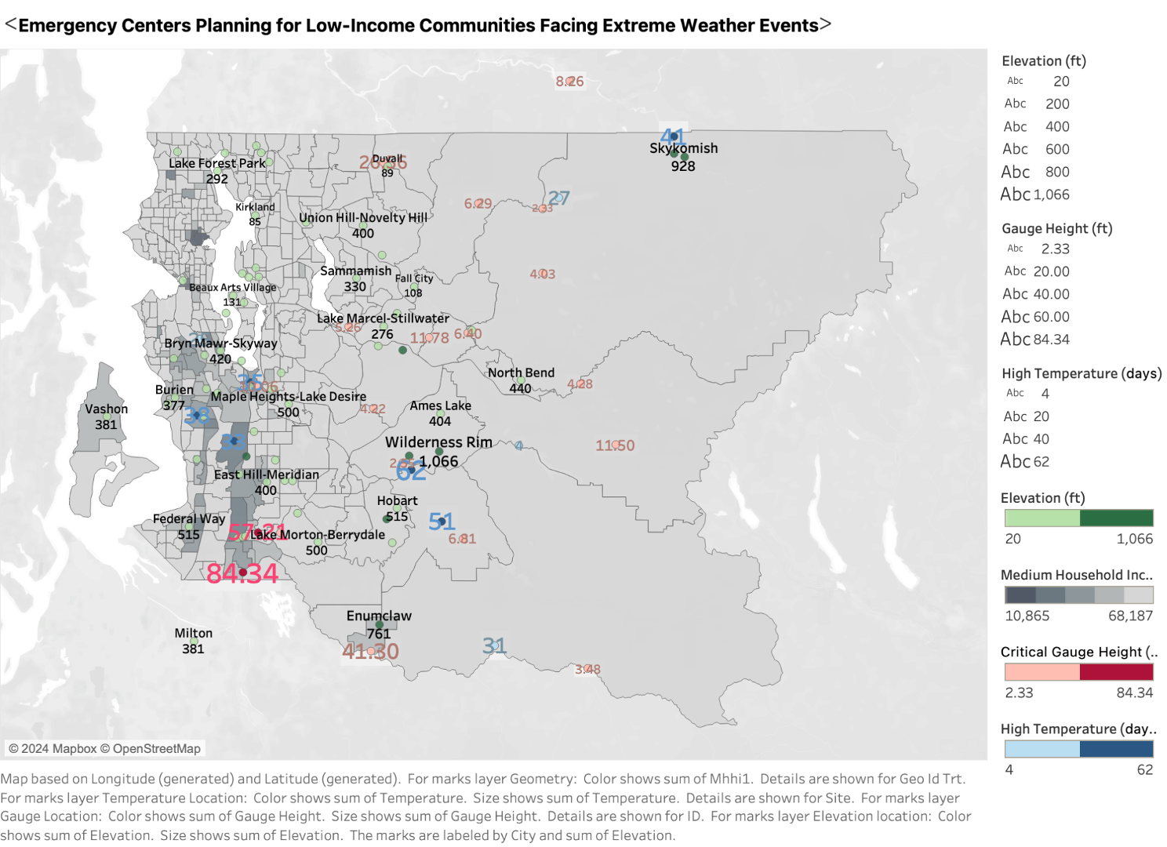
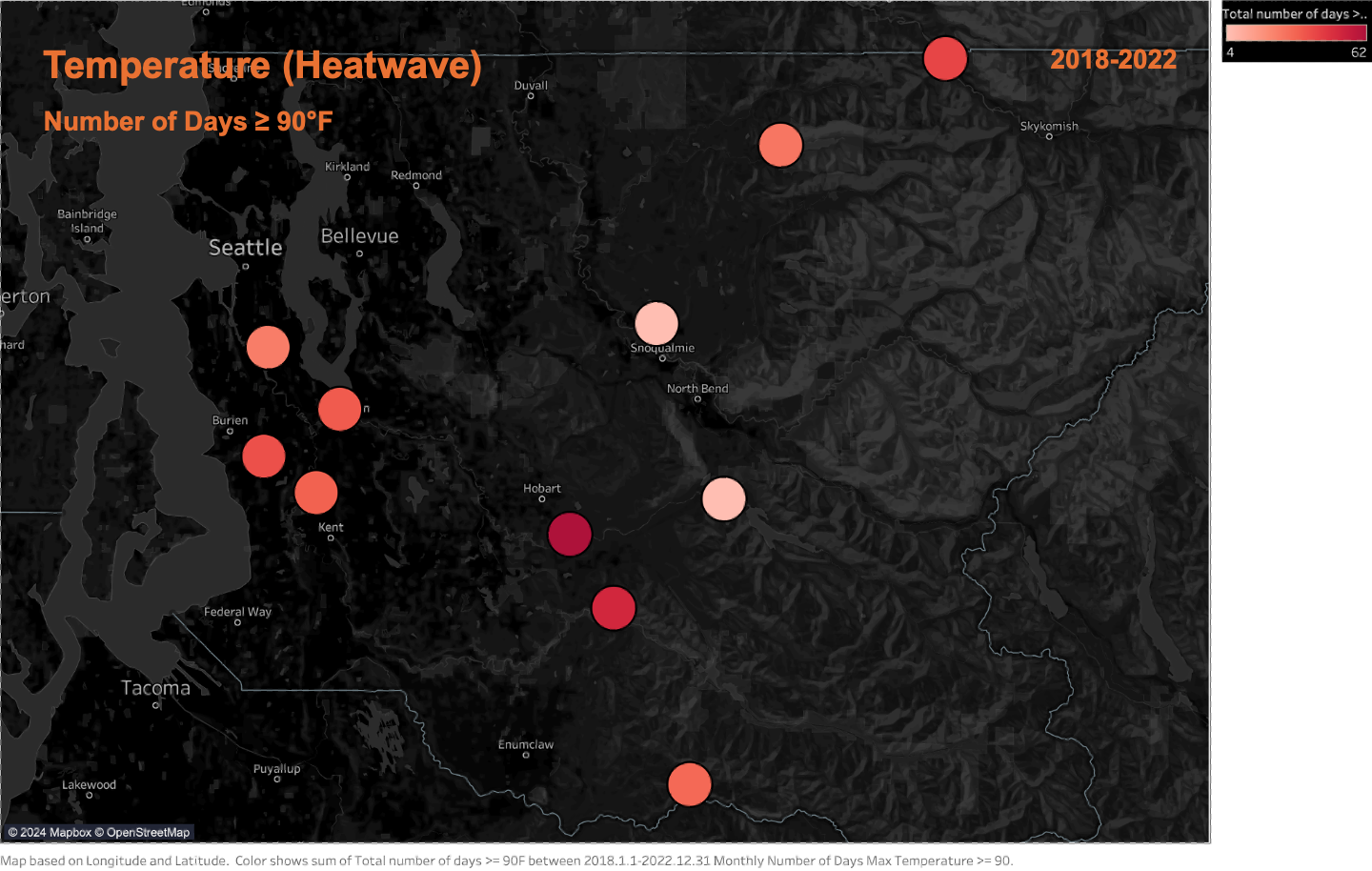
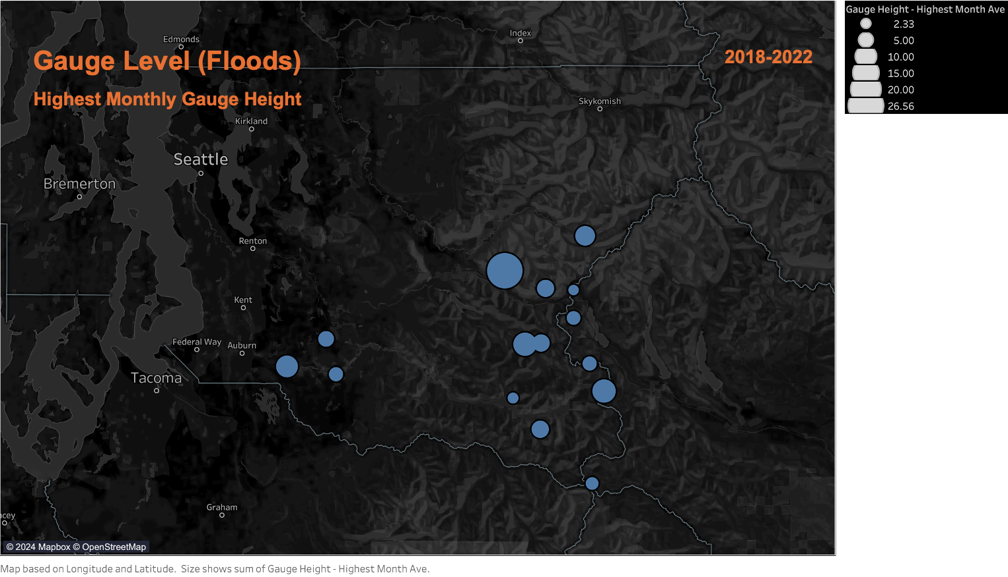
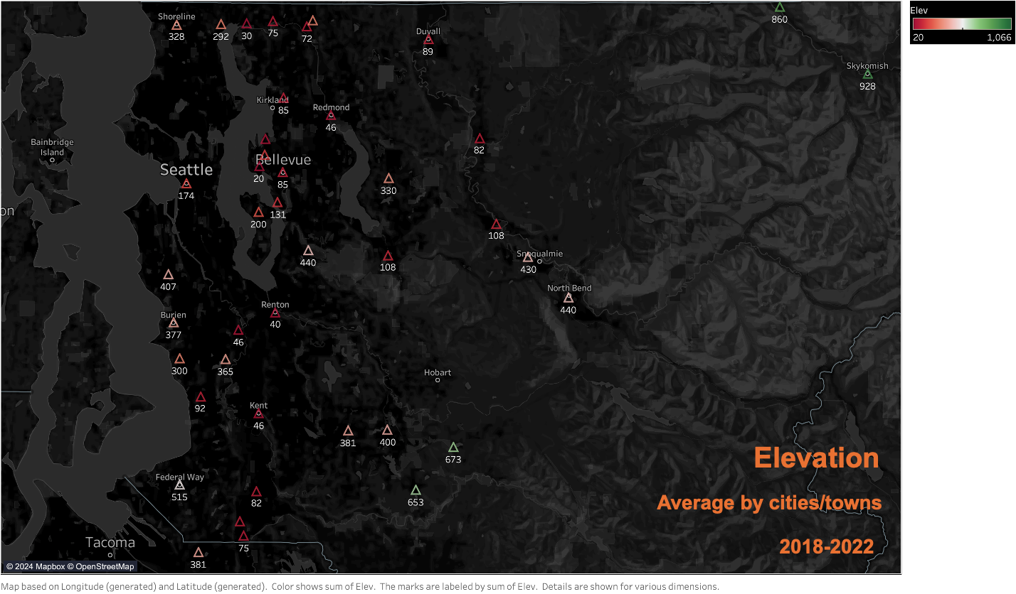
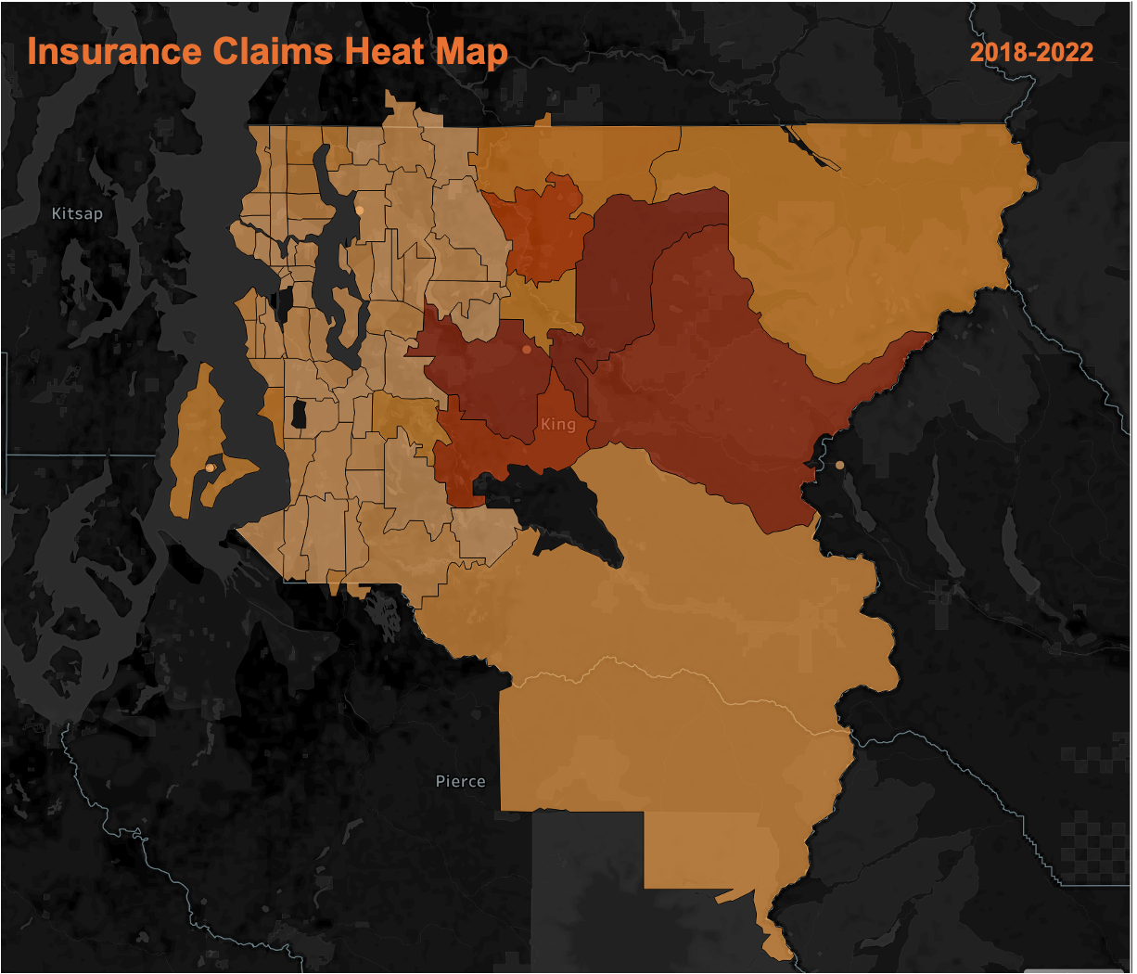
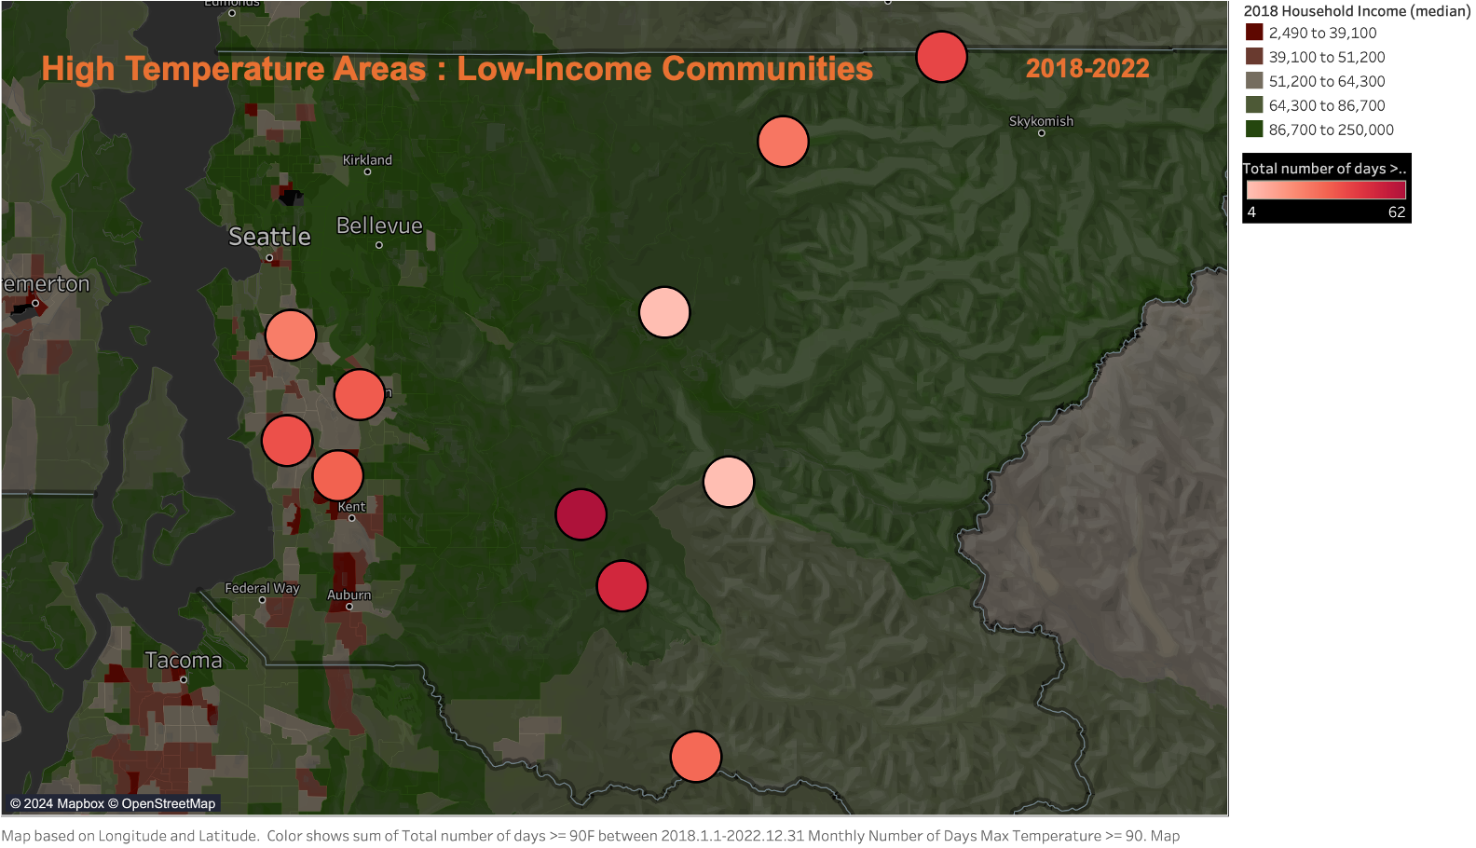
Future Steps:
Add additional dataset layers, such as road closures, infrastructure damage, educational resources, and marginalized community demographics.
Expand the project to other geographic areas outside King County and include additional extreme weather events, such as hurricanes and earthquakes.
Challenges:
Building Resources and Connections: Collaborating with experts and community leaders from different fields and bringing ideas to life.

